Slide 1
SPM PM REVIEW
G1T8 - LET'S GIT IT
HILYA SYAZWANI
LIM HUI SIN
LIM JIE MIN
TAN XIN RONG STEFFI
KU SEOUNGLIM (SKY)

Slide 2

OVERVIEW
FUNCTIONALITIES
SCHEDULE
BIRD’S EYE VIEW
WORK DIVISION
BUFFER TIME
CRITICAL PATH ANALYSIS
BUG METRICS
ROLES & RESPONSIBILITIES
ROLE ALLOCATIONS
PP AND PM ROTATIONS
RISKS

Slide 3
FUNCTIONALITIES
Do you plan to drop / add any functionalities?
As of now, our team does not plan to drop/add any functionalities.
Do you plan to use any PHP frameworks?
We will not be implementing any PHP frameworks.
Did you manage to finish login + 1 functionality?
We managed to finish the login page (1.1), and nearly completed the bidding results table (1.5) and bootstrap (2.2), both of which will be pushed to Iter 2.
This occurred as bootstrap took much longer than expected. To mitigate against further scheduling risks, we rescheduled the remaining iterations to include more buffer time.
Cloud deployment details:
IP Address: http://54.255.141.164/
Admin Password: g1t8SPMacc@
Notes:
Functionalities
Do you plan to drop/add any functionalities?
Do you plan to use any PHP frameworks?
Did you manage to finish login + 1 functionality? (**NEW**)
What functionalities have you finished? (**NEW**)
What is the IP address & admin password for your cloud deployment? (**NEW**)

Slide 4
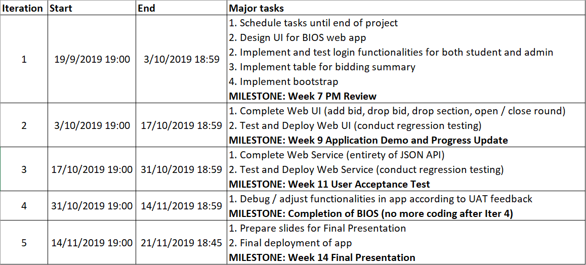
SCHEDULE
Bird’s eye view
Notes:
Schedule
Tell us your schedule. Do not show us the raw schedule on Google Sheets. Summarize it but give us sufficient details to have a bird’s-eye view of your project.
What are your planned iterations and what are the tasks in each iteration?
When is each iteration starting and ending?
Who is doing what?
What are your milestones?
How much buffer time do you have?
Show us your critical path.

Slide 5
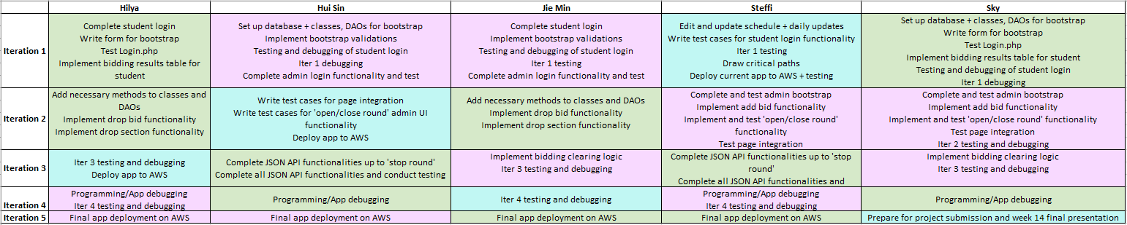

SCHEDULE
Who is doing what? - Task breakdown per member

Slide 6
SCHEDULE
Who is doing what? - Task breakdown per member

Slide 7
SCHEDULE
How much buffer time do you have?
For every task on the schedule, there is a buffer time of 1-5 days between tasks, unless the tasks are concurrent.

Slide 8
CRITICAL PATH ANALYSIS
Iteration 1 - 12 days
1 First meeting and initial planning
3 days
3 Set up database, write code for classes and DAOs
1 day
4 Complete student login
1 day
6 Implement bidding summary and results table for student
1 day
5 Implement validations for bootstrapping
1 day
7 Team meeting, testing and debugging for login
1 day
Normal task
First / last task
Critical path
10 Week 7 PM Review
1 day
9 Prepare and submit slides, deploy app
3 days
8 Implement and test admin login
1 day
2 Daily updates
14 days

Slide 9
CRITICAL PATH ANALYSIS
Iteration 2 - 6 days (2 paths)
4.2 Implement and test ‘drop bid’ functionality
1 day
4.1 Complete ‘bidding results’, implement and test ‘add bid’ functionality
1 day
3 Add necessary methods to classes and DAOs
1 day
4.3 Implement and test ‘drop section’ functionality
1 day
6 Iter2 regression testing and debugging
1 day
7 Prepare and submit slides
1 day
5 Implement and test ‘open/close round’ functionality
1 day
8 Deploy app
1 day
2 Complete and test admin bootstrap
1 day
9 Week 9 Application Demo and Progress Update Presentation
1 day
1 Daily updates
14 days

Slide 10
CRITICAL PATH ANALYSIS
Iteration 3 - 5 days (2 paths)
2 Implement and test bidding clearing logic
1 day
4 Iter3 testing and debugging
1 day
5 App deployment
1 day
3.1 Write test cases for JSON API
1 day
3.3 Finish the remaining JSON API functionalities
1 day
3.2 Complete JSON API functionalities up to ‘stop round’
1 day
6 Week 11 User Acceptance Test
1 day
1 Daily updates
14 days

Slide 11
CRITICAL PATH ANALYSIS
Iteration 4 - 4 days
2 Team meeting and plan (with UAT feedback)
1 day
3 Programming / app debugging (Part 1)
1 day
4 Programming / app debugging (Part 2)
1 day
5 Iter4 testing and debugging
1 day
1 Daily updates
14 days

Slide 12
CRITICAL PATH ANALYSIS
Iteration 5 - 4 days
2 Prepare slides for Week 14 submission
2 days
3 Check and submit all project files in repository
1 day
5 Week 14 Final Presentation
1 day
4 Final app deployment
2 days
1 Daily updates
3 days

Slide 13
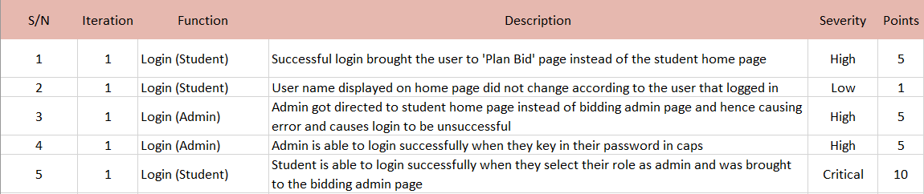
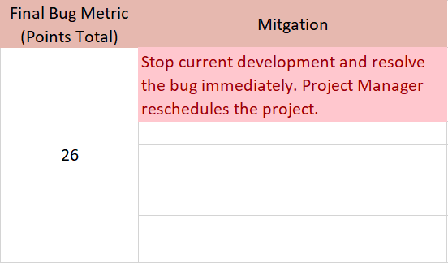
BUG METRICS
All bugs were found during the scheduled testing and debugging sessions for each functionality. All bugs were hence debugged and resolved immediately, without needing to reschedule.
Notes:
Bug Metrics
What is the current value for the metric & did you have to take any action according to your mitigation plan?

Slide 14
ROLES & RESPONSIBILITIES
Role allocations for each iteration
Iteration 1
PM: Steffi - Milestone: Week 7 PM Review
Coder: Hui Sin, Jie Min, Hilya, Sky
Iteration 2
PM: Hui Sin - Milestone: Week 9 Application Demo and Progress Update
Coder: Steffi, Jie Min, Hilya, Sky
Iteration 3
PM: Hilya - Milestone: Week 11 User Acceptance Test
Coder: Steffi, Hui Sin, Jie Min, Sky
Iteration 4
PM: Jie Min - Milestone: Completion of BIOS
Coder: Steffi, Hui Sin, Hilya, Sky
Iteration 5
PM: Sky - Milestone: Week 14 Project Submission and Final Presentation
Coder: Steffi, Hui Sin, Jie Min, Hilya
Notes:
Roles & responsibilities
Who is doing what (Project Manager, coder, etc.)?
What is the rotation plan? List specifically the PM is in charge of which milestone?

Slide 15
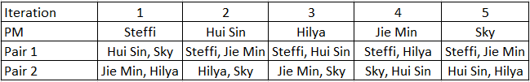
ROLES AND RESPONSIBILITIES
Pair programming and PM rotations
Notes:
What are the pair programming teams and the rotation plan for the teams?

